Slide 1



RISEN GAMING
ONLINE GAME KEY
SHOPPING SYSTEM
SCHOOL PROJECT: WEBSITE
INSTRUCTOR: PROF. HIEU

Slide 2

CONTENT
01
ABOUT US & OUR TEAM
02
DEMONSTRATION
03
SYSTEM DESIGN
04
TECHNOLOGIES
05
LIMITATION & NEXT PROJECT

Slide 3

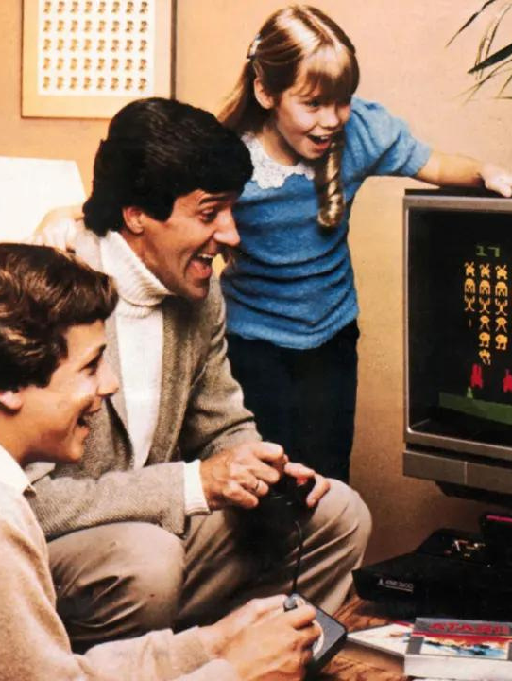



I. ABOUT US
Members: Vo Nguyen Duy Bach – Nguyen Gia Bao – Hoang Duc Hung – Hoang Ngoc Anh Khoi – Pham Phuc Khoa – Le Duc Minh – Nguyen Tuan Ngoc
We chose to implement a game store type because in recent years the virus and the lock down and everybody had to stay inside there home. Due to this, the need to kill times and entertain rose greatly./* Even more, new technologies are upgraded daily so more people willing to give it a try in their new game. and more game means more ways to buy and play it */

Slide 4

GENERAL IDEAS
Project name: Online Game Key Shopping System
Project type: Website
Target audience: Gamers of all ages

Slide 5
II. DEMONSTRATION

Slide 6
II. DEMONSTRATION
HOMEPAGE
CUSTOMER
ADMIN
PRODUCT
BRANDING
ToU
PRIVACY POLICY
FAQ
SEARCH PAGE
USER SIGN UP
USER SIGN IN
USER DASHBOARD
ADD TO CART/CHECK OUT FUNCTION
ADMIN SIGN UP
ADMIN SIGN IN
ADMIN ADD PRODUCT
ADMIN EDIT PRODUCT

Slide 7
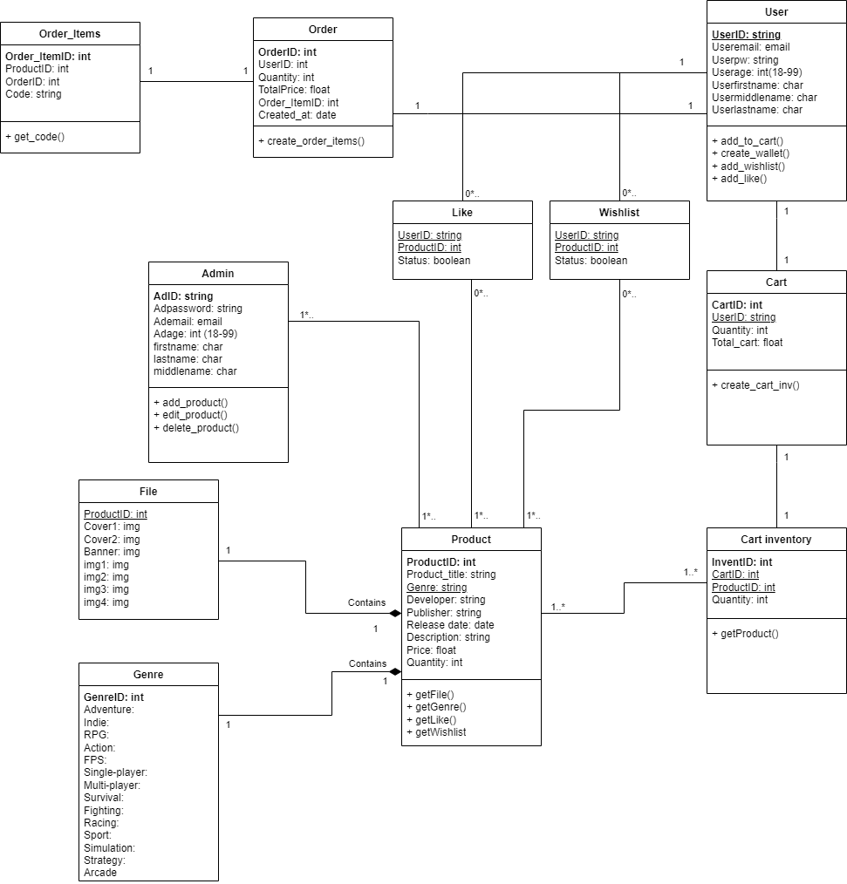
III. SYSTEM DESIGN
Class Diagram

Slide 8
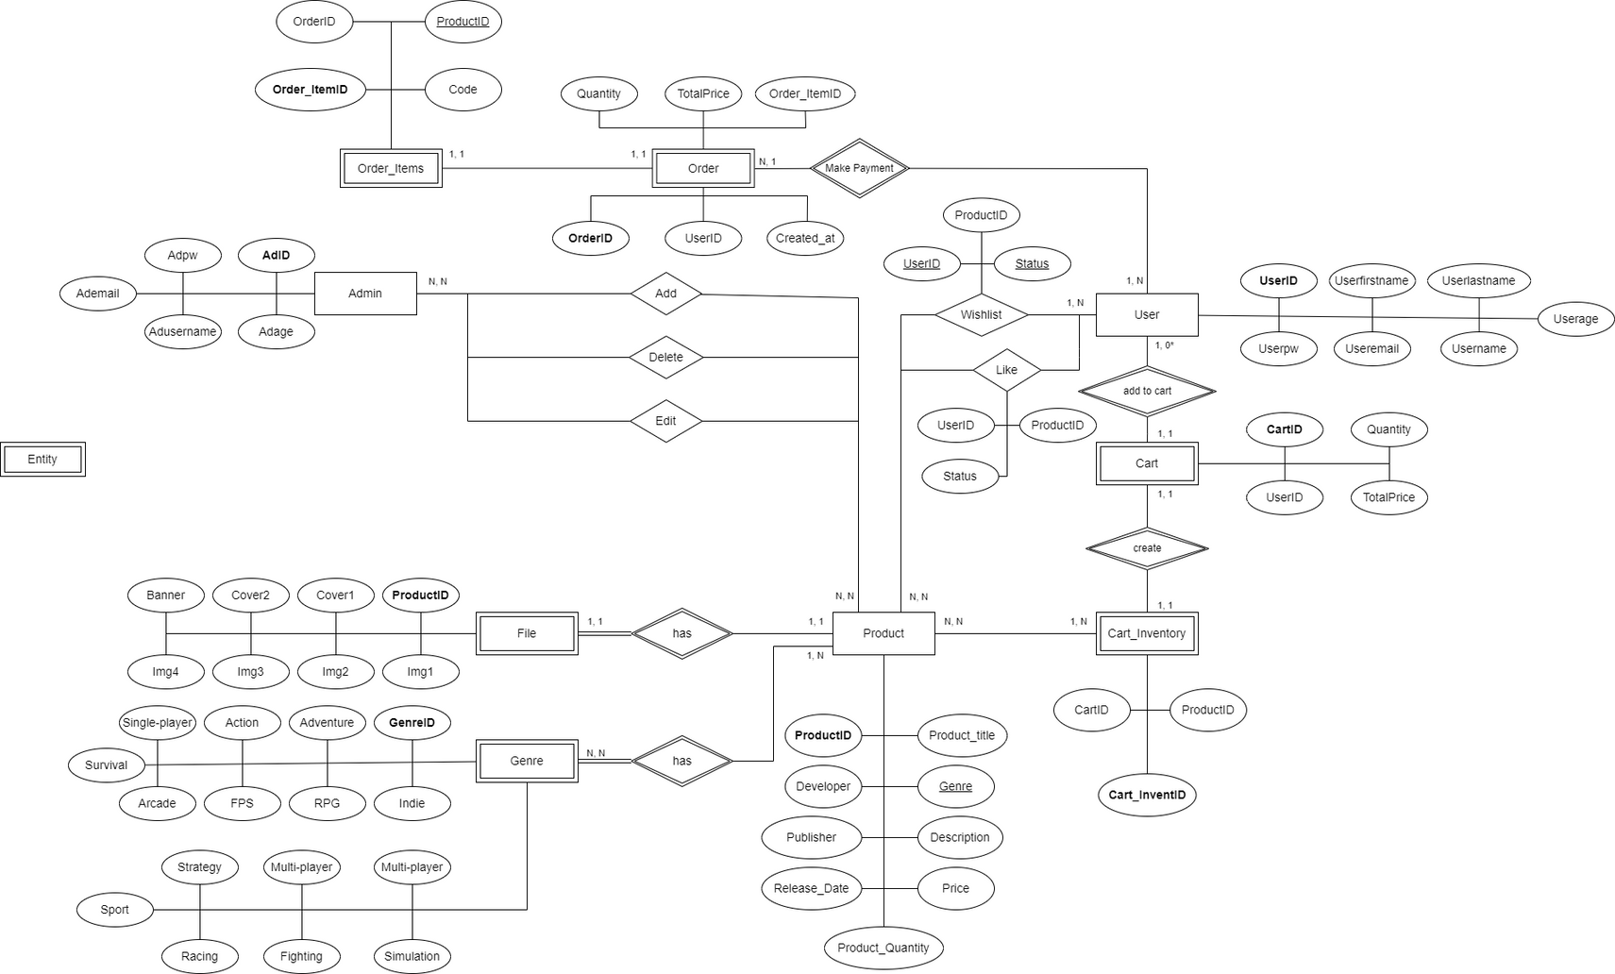
III. SYSTEM DESIGN
Database Design

Slide 9
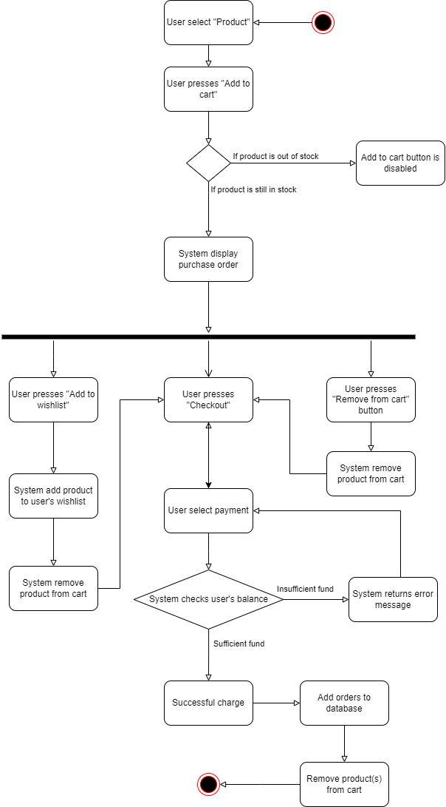
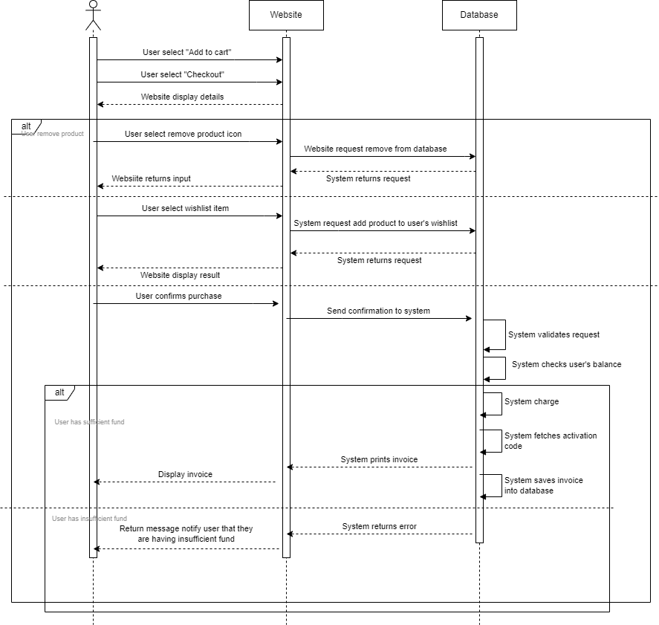
III. SYSTEM DESIGN
Product Purchase

Slide 10
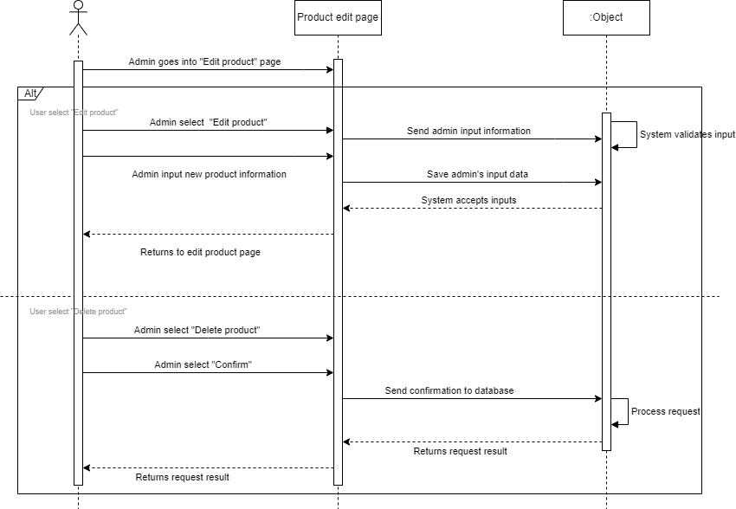
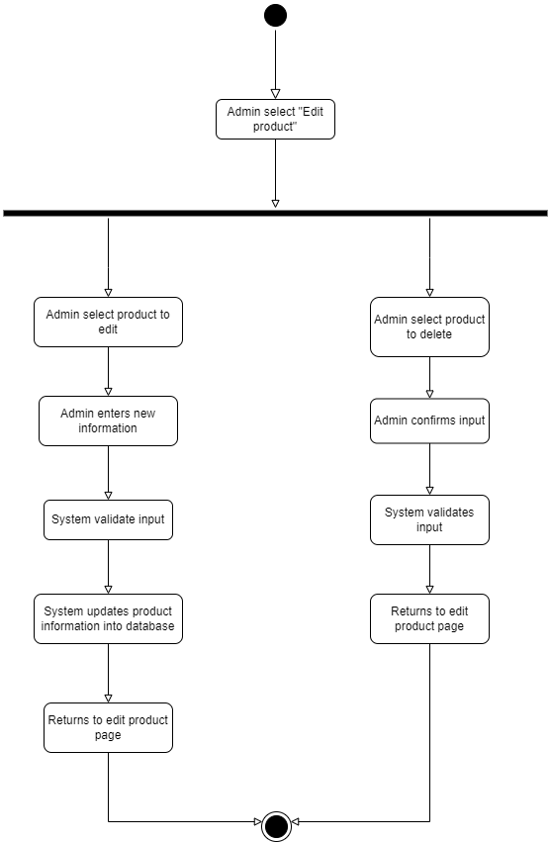
III. SYSTEM DESIGN
Admin Edit Product

Slide 11
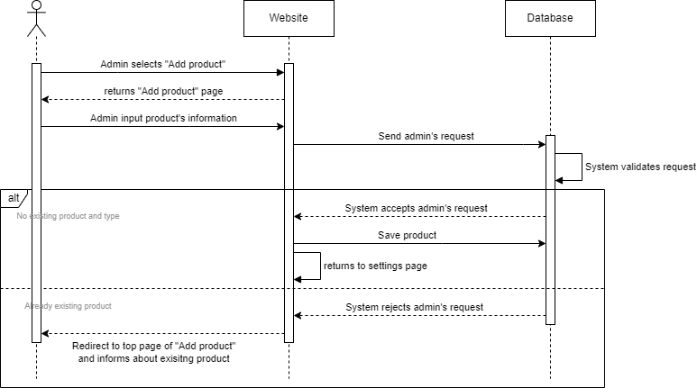
III. SYSTEM DESIGN
Admin Add Product

Slide 12
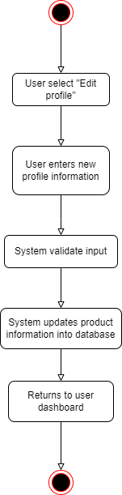
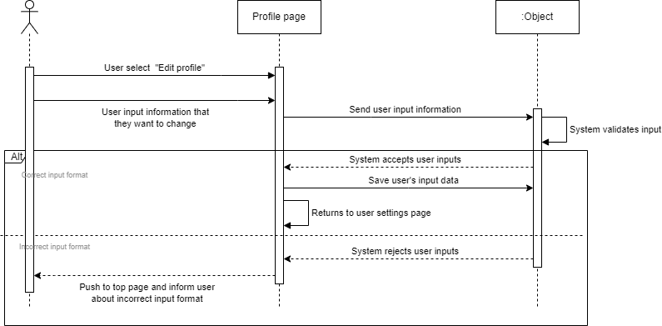
III. SYSTEM DESIGN
User Edit Profile

Slide 13
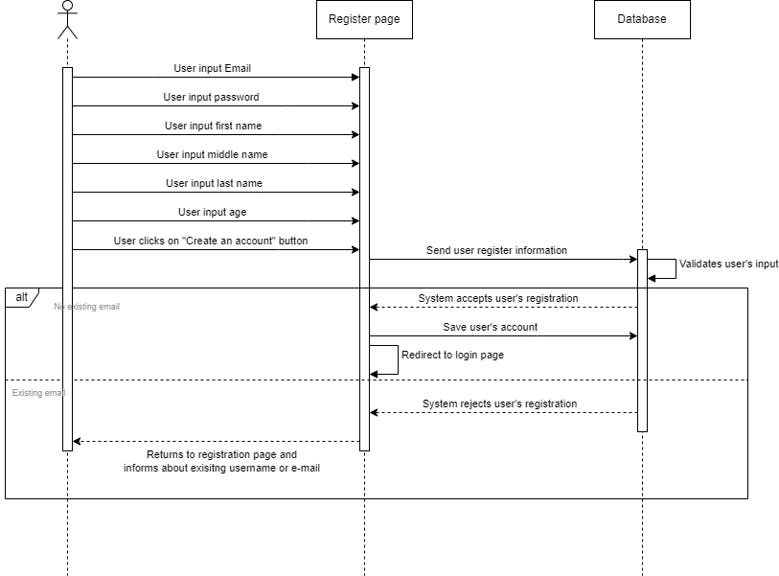
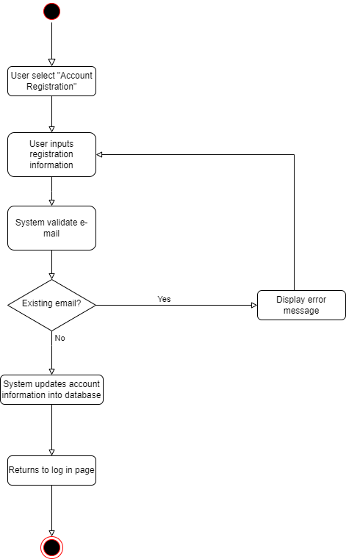
III. SYSTEM DESIGN
User Register Profile

Slide 14
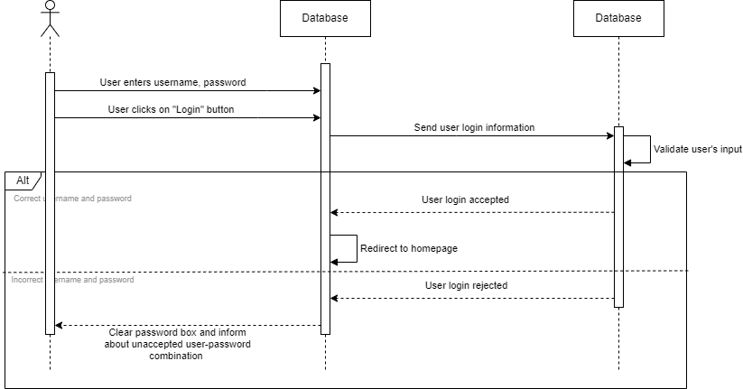
III. SYSTEM DESIGN
User Login

Slide 15
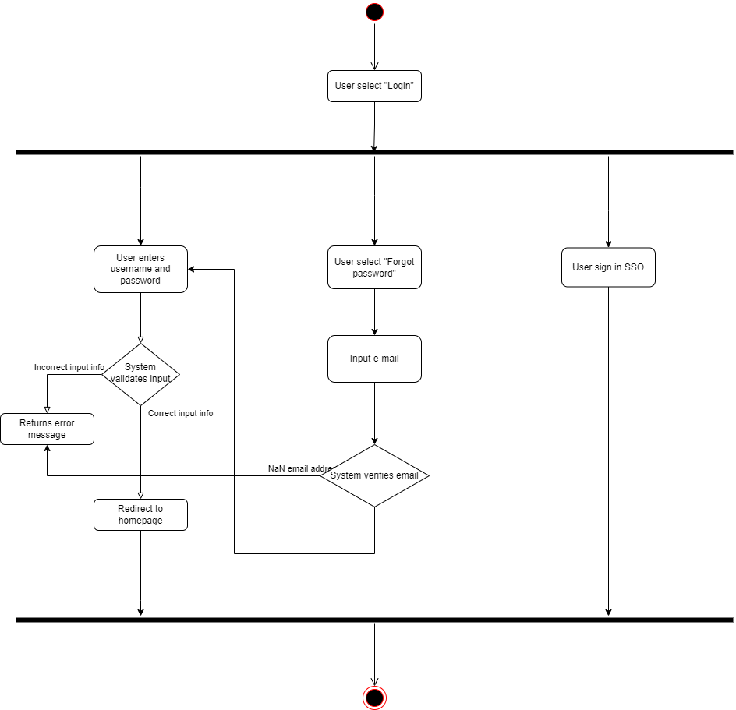
III. SYSTEM DESIGN
User Login

Slide 16






IV. TECHNOLOGIES
React JS is not fully featured but has the advantage of open-source JavaScript User Interface(UI) library, which helps to execute the task in a better manner, solved that issue and makes it easier. It provides less coding and gives more functionality. A ReactJS web application is made up of multiple components, and each component has its own logic and controls. These components are responsible for outputting a small, reusable piece of HTML code which can be reused wherever you need them.
DOM stands for “Document Object Model” exists entirely in memory and is a representation of the web browser's DOM, we are writing virtual components that react will turn into the DOM, leading to smoother and faster performance.

Slide 17
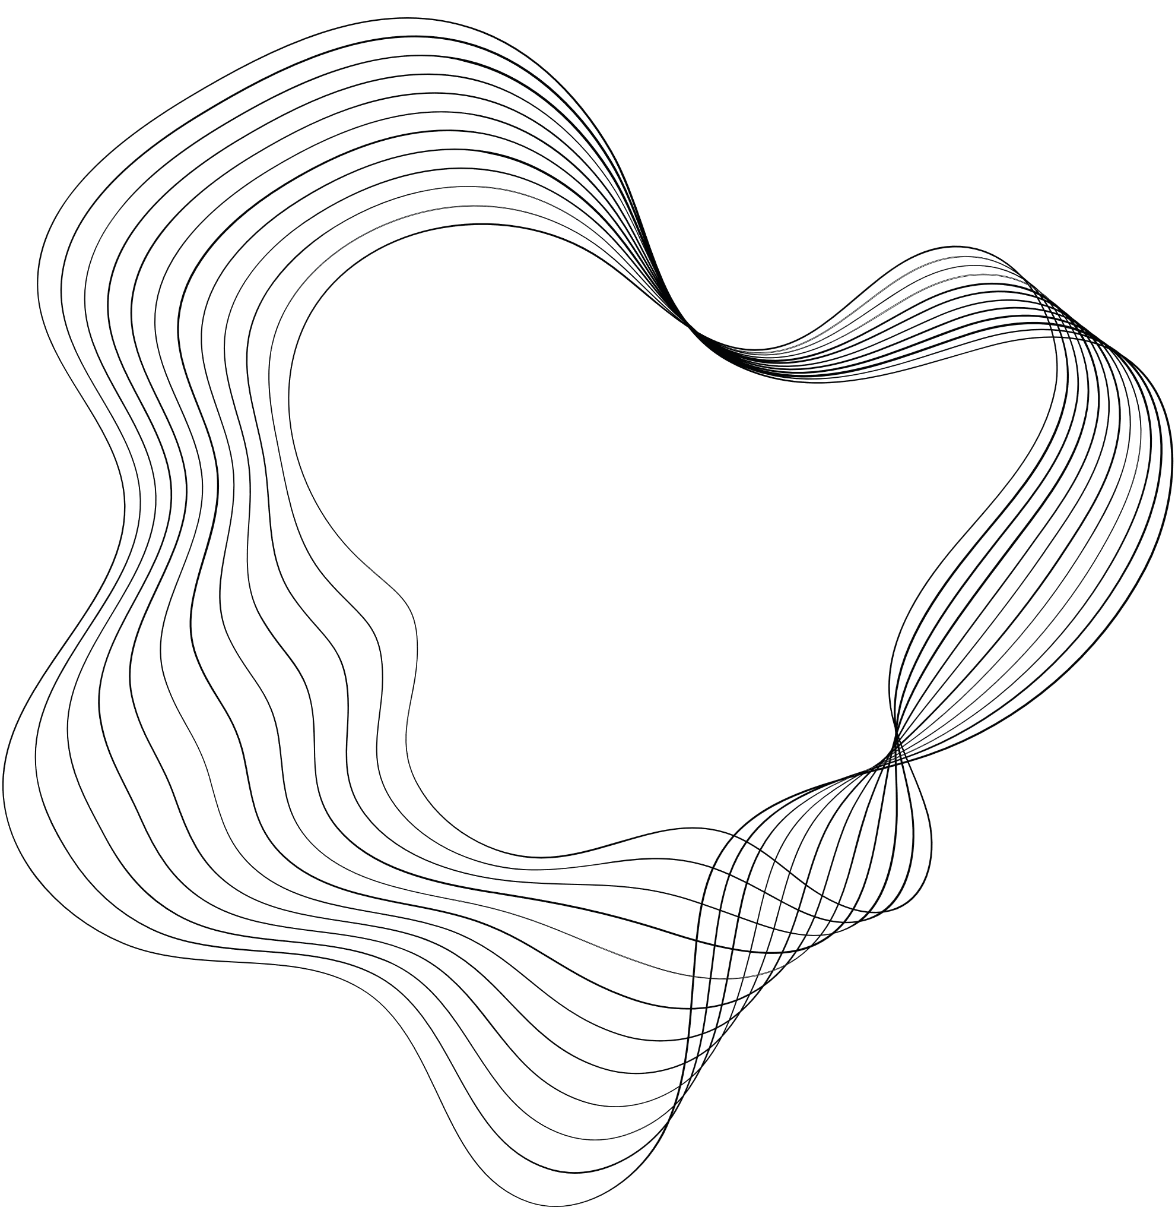
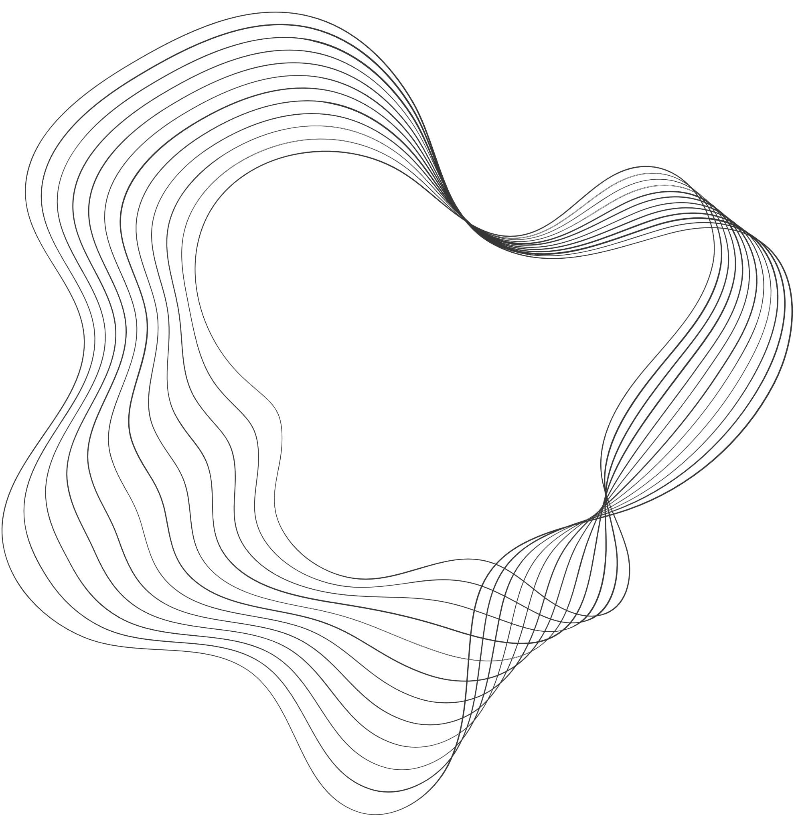
V. LIMITATION
Doesn’t have recommendation AI mechanism.
Doesn’t have Promotion system for customers.
Add product function by using <html> tag can be compromised by XSS
Not responsive.
Unoptimized search function
Admin dashboard lacks statistic report

Slide 18
V. FUTURE PLAN
FIXING EVERY EXISTING LIMITATIONS
HOW ?
AI mechanism that can analyze customer’s behavior based their click activity or purchase history
Statistic report that can stores business income and graph display
Responsive website for majority of devices
Optimized search function
OPTIMIZED USER’S EXPERIENCE BY USING SERVER SIDE RENDERING

Slide 19


THANK'S FOR WATCHING
RISEN GAMING

